Slide 1

14.8 BILLION HECTARES
6.8 BILLION INHABITANTS
2.1 HECTARES PER PERSON
Or about 0.7 ha of useful land per person

Slide 2
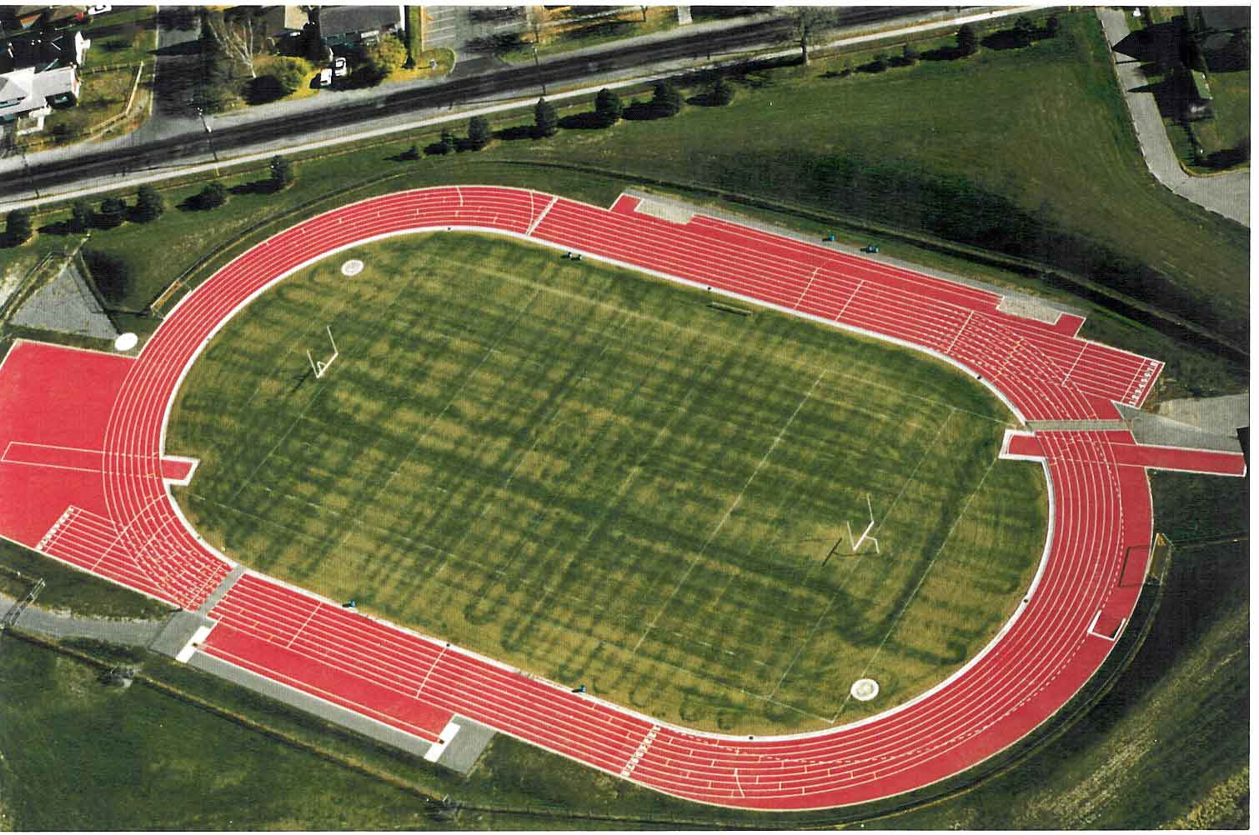
100m

Slide 3
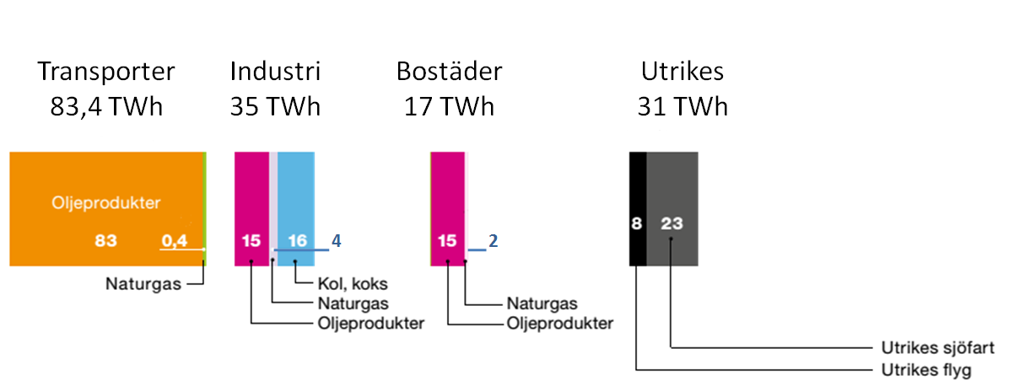
konsumtion
Per år
Siffror från energimyndigheten
TWh | TRANSPORT | INDUSTRI | BOSTÄDER | UTRIKES | TOTALT
Olja | 83 | 15 | 15 | 31 | 144
Gas | 0,4 | 4 | 2 |  | 6,4
Kol |  | 16 |  |  | 16
Miljon Ton CO2 | 20,45 | 9,43 | 4,05 | 7,61 | 41,55
Per person | 2,27 | 1,05 | 0,45 | 0,85 | 4,62
Kalkyl baserat på standard värden, Stephen Hinton Consulting

Slide 4
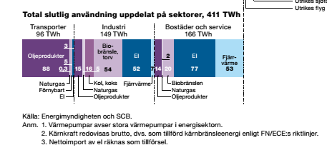
45 MWh per person (19MWh from fossil sources)
Equivalent to 12 barrels of oil/year
27,831 SEK

Slide 5
POLICY PERFORMANCE
Basic needs of citizens
NOT MET
MET
Sustainable
Poverty:
People lack basics but capital intact
Sustainable
Future
Maintaing/increasing
Capital Stewardship
Failed society
Capital depleted, people not served
Capital
depletion:
People served at expense of coming generations
Depleting

Slide 6
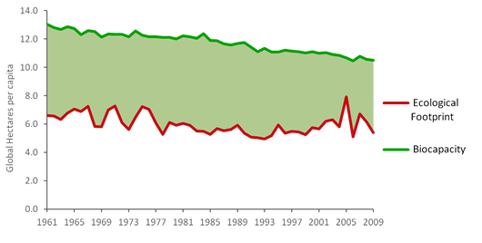

Slide 7
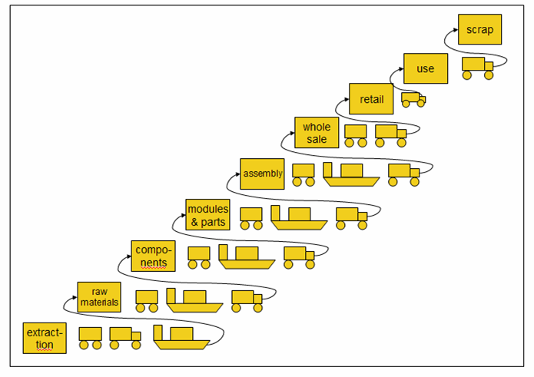
Companies whose profit margins depend on merchandise made by factories 12,000 miles away simply won't function in a world of $100-plus barrels of oil.
Notes:
Ericsson model “sand to chip” huge transport cost let alone energy used at each step.

Slide 8
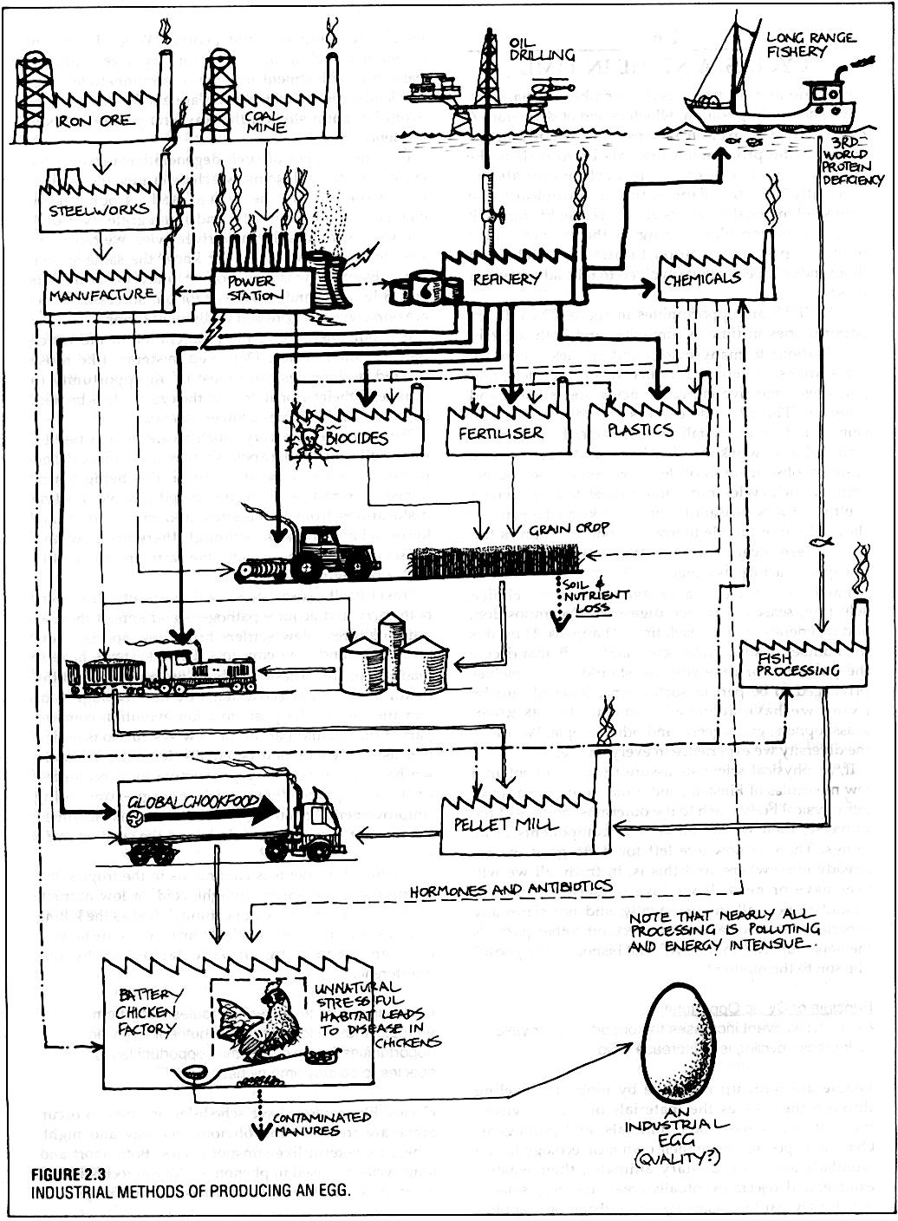
Notes:
Example of linear thinking

Slide 9
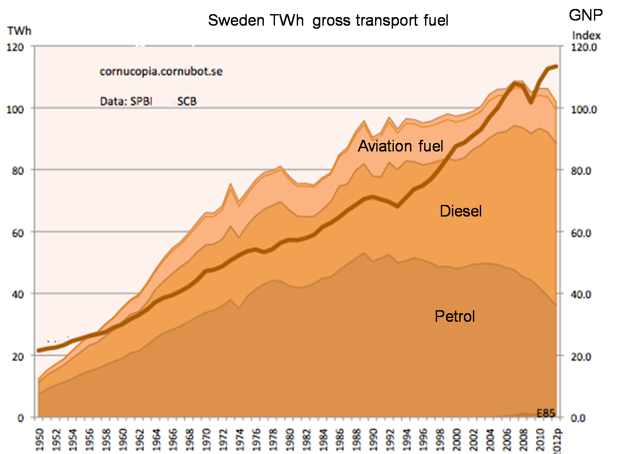
Farsta 9

Slide 10
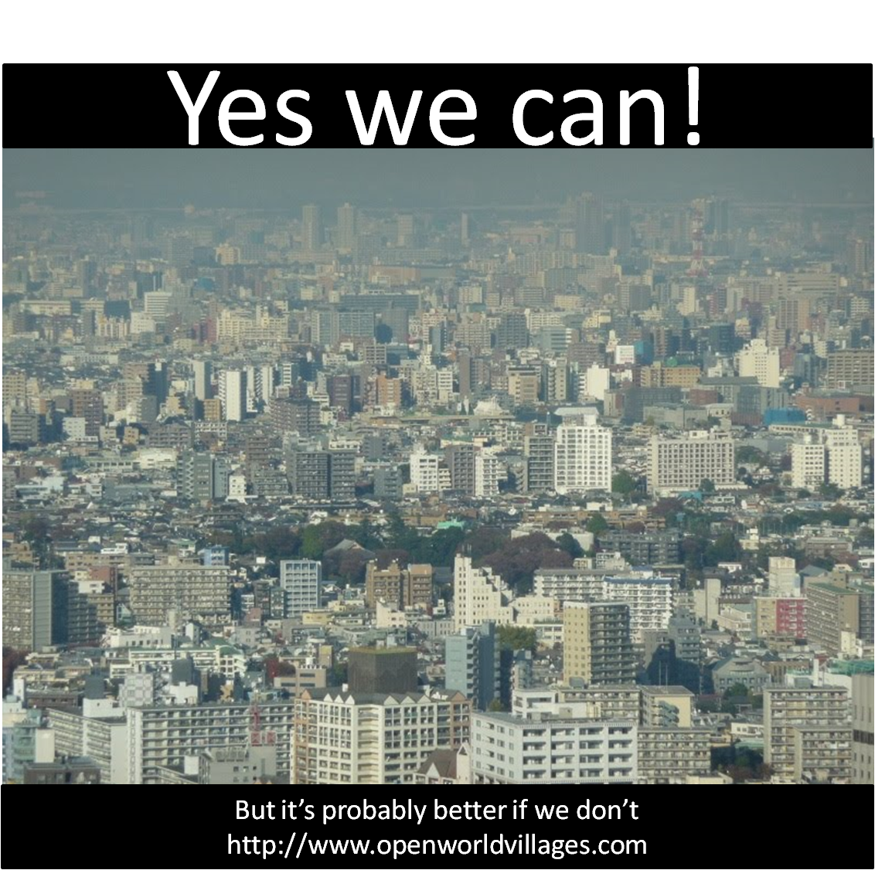

Slide 11
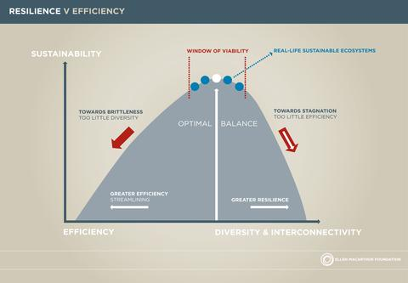

Slide 12
BUILT INFRASTRUCTURE
Energy intensity in operation
HI
LO
Highest energy intensity approach
Built to use a 100 years
Energy intensity in production
LO
HI
Made to require energy
Made for repair or recyle

Slide 13
HARVESTED
EXCESS
BIOMASS
PYROLYSIS
Biochar
Dry
Wet
CO2
Heat
Sun
Electricity
BIOGAS
Co2
CO2
Propulsion
Compost
COMPOST
C2H4
CO2
Compost
Notes:
13

Slide 14
Peak Oil
Climate System
Disruption
Economic System
Dysfunction

Slide 15
Peak Oil
Climate System
Disruption
Economic System
Dysfunction
THE RESILIENT VILLAGE...
Provides nutritious food and wonderful shelter affordably
Is insensitive to fossil fuel price hikes
Has a strong community that can respond to climate change
Gives you a place to be with a clear social conscience
Enables you to be the change you want to see
Provides something you can pass on to your children

Slide 16
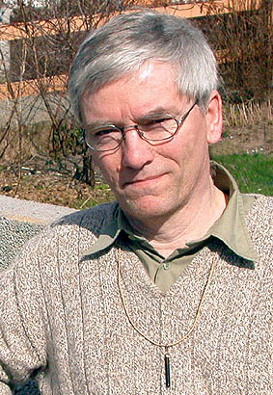
Folke Günther
Systems Ecologist
Since 1970’s:
Researched back to 1600’s
Lived self-sufficient
Tried everything practically
Encouraged others tirelessly
http://holon.se

Slide 17
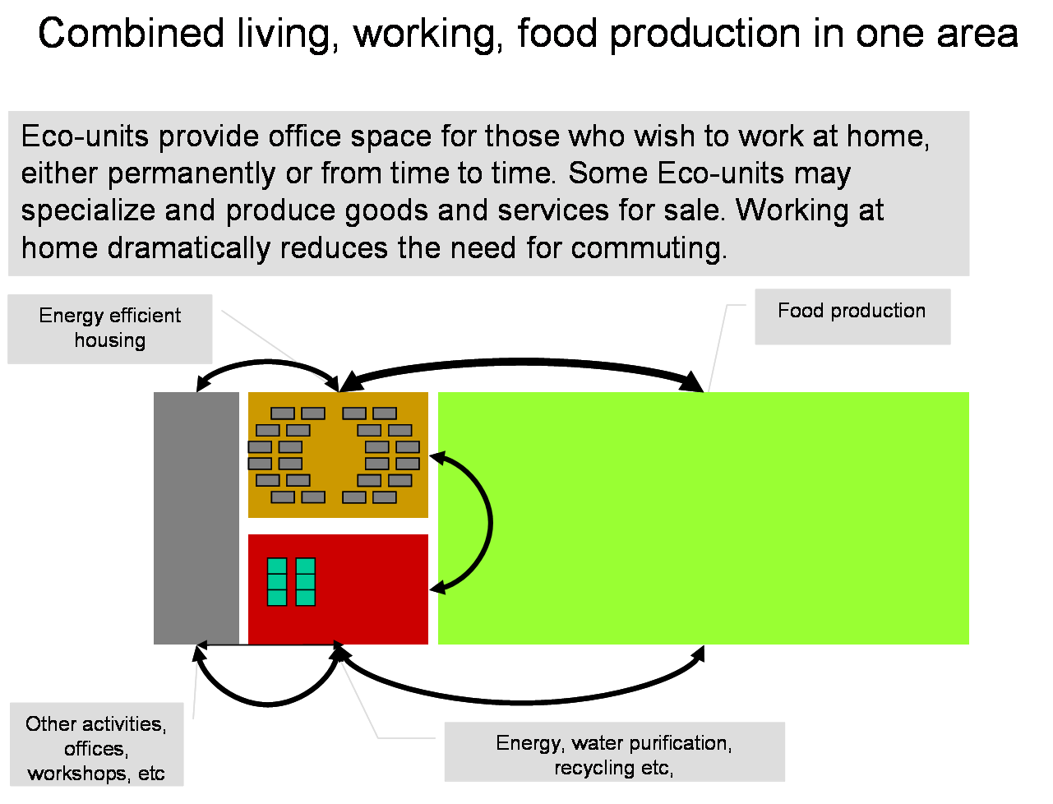

Slide 18
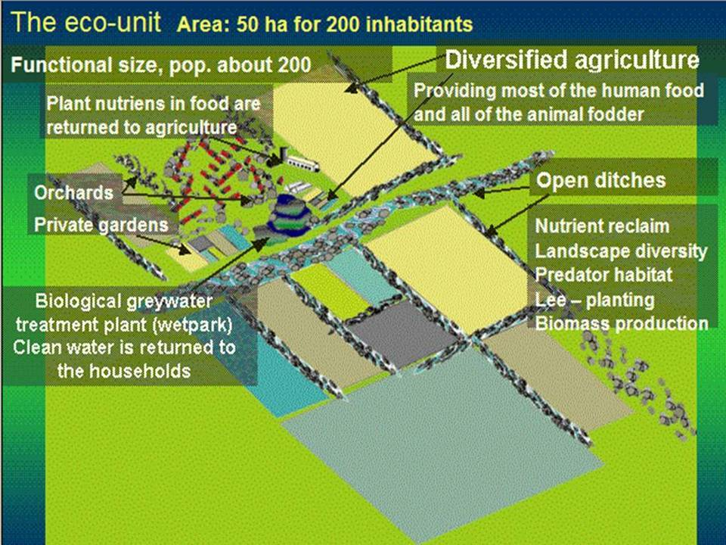

Slide 19
Sun
Wind
Water
Water

Slide 20
100 friends (with their children) and
A farmer
Some land access - one hectar per family
Some woods and other land

Slide 21
>
Bär, nötter, svamp
Skog
Ved
Virke
Ved
Svamp
Bär
Nötter
Betesmark
kött
kött
Åker
foder, halm
grönsaker
grönsaker
foder, halm
Vatten
system
Vatten fisk
Vatten
Vatten
vatten
vatten
vatten
vatten
vatten
Frukt
Bär
Frukt,
bär
Fall frukt
Frukt,
bär
kompost
Växthus
Plantskola
kompost
Plantor
Grönsaker
kompost
kompost
ogräss
plantor
grönsaker
Djur-hållning
kött
gödsel
kött
gödsel
Höns
ägg
Friland
Odling
Frukt,
bär
regnvatten
Verkstäder
mm
El
El
El
regnvatten
Gemensamhets lokaler
Biochar, värme
Värme-
panna
Biochar, värme
värme
värme
matavfall
Kök
Gråvatten, Urin, fekalier
Gråvatten, Urin, fekalier
Bad
Toa

Slide 22
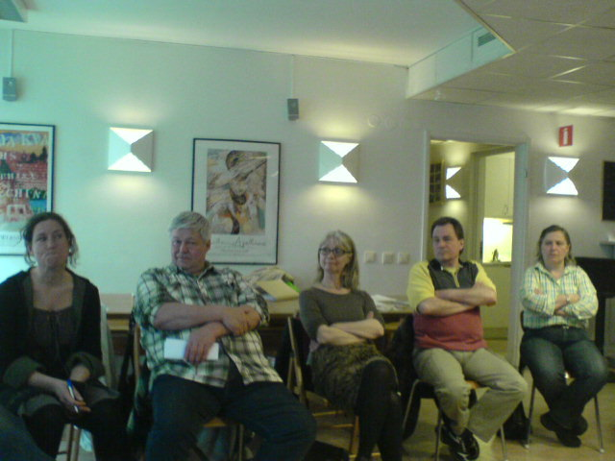
REALITY NUMBER ONE:
You are starting a business together that is worth
anything from EURO 2- 6 million

Slide 23
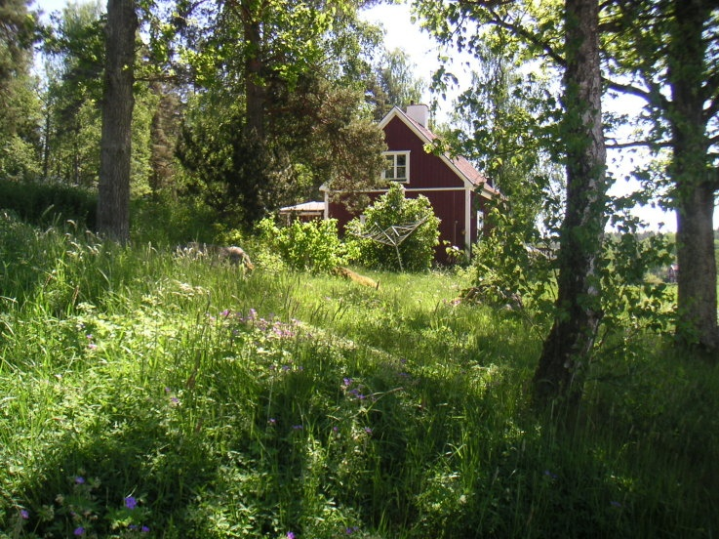
OPPORTUNITY NUMBER ONE:
Your investment will give you what you need – a great place to live and organic food – whatever the economic situation

Slide 24
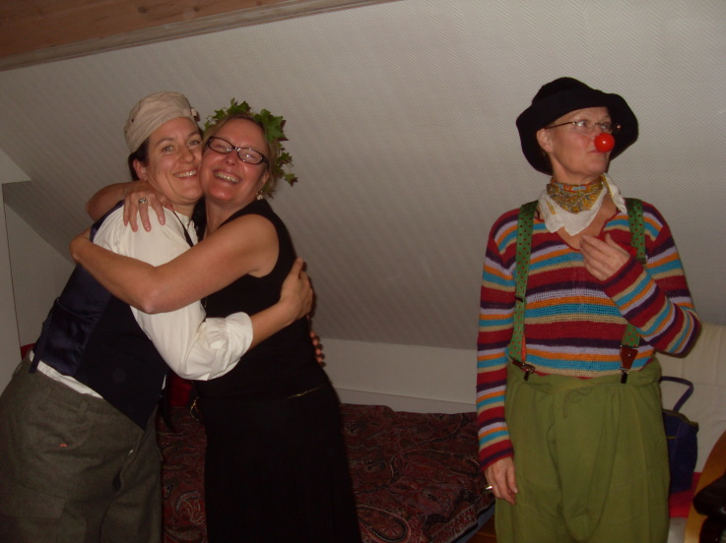
REALITY NUMBER TWO:
It is like entering into a new relationship, with all the
associated fun and trials and tribulations…..

Slide 25
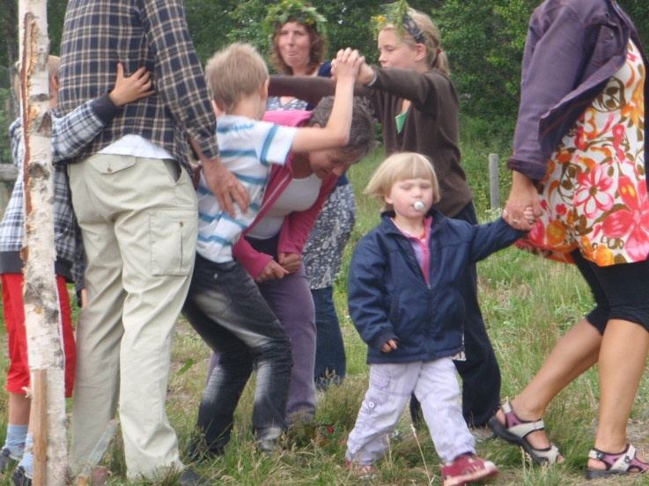
OPPORTUNITY NUMBER TWO:
You get a lot of new friends and be in a group of people who will support each other

Slide 26
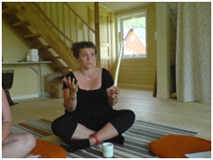
REALITY NUMBER THREE:
You are embarking on a personal development course

Slide 27
OPPORTUNITY NUMBER THREE:
You are embarking on a personal development course

Slide 28
Business Plan
Stage one: legal organisation - youth hostel
Stage two: weekend/holiday home
Stage three: CSA scheme
Stage four: permanent home
Stage five: home and work-life platform

Slide 29
Co-operatives
Your investment gives value while it is with the organisation
Have a ready made democratic legal structure
Tried, tested and accepted

Slide 30
Limited companies
Your investment gives value when you sell it
Means many people can be involved with a small amount of money
Should give the equivalent or more of what you can get in the bank
Could provide other benefits like rebates on goods bought.

Slide 31
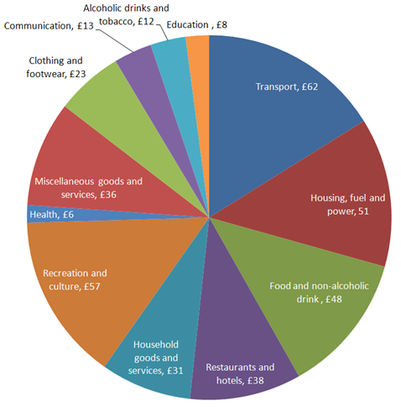

Slide 32
61% of the fuel is used after food leaves the fields

Slide 34
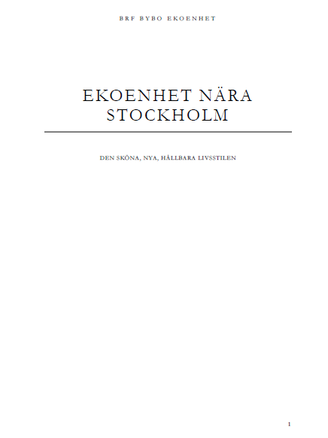
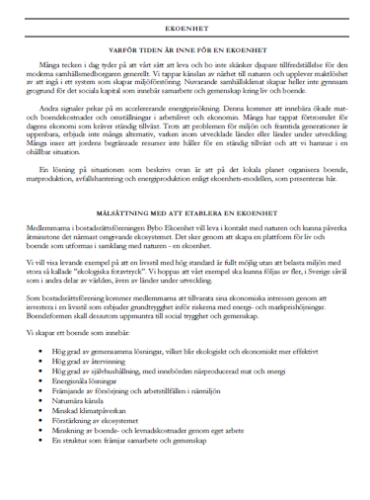
Write the prospectus and gain clarity

Slide 35
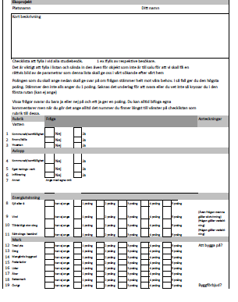
Checklist for land

Slide 36
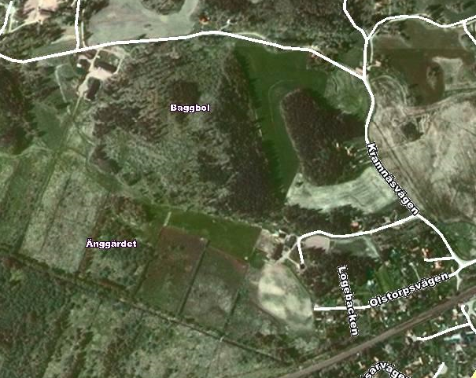

Slide 37
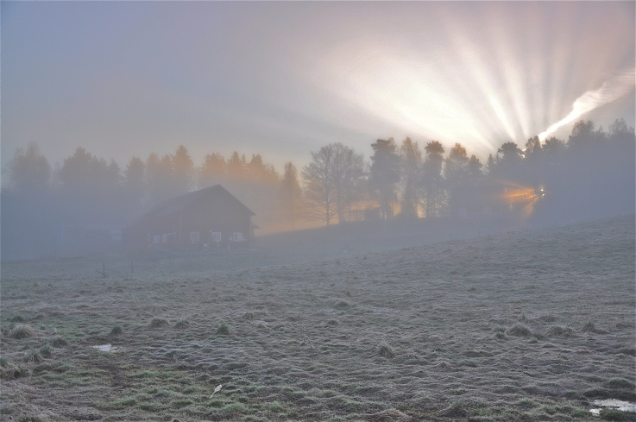
SO FAR

Slide 38
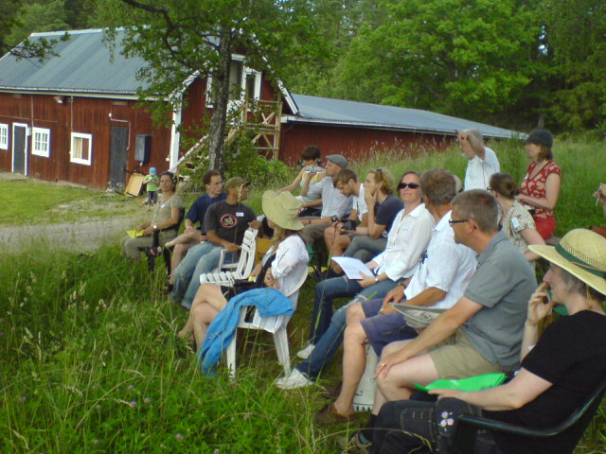
We have hosted some amazing courses

Slide 39
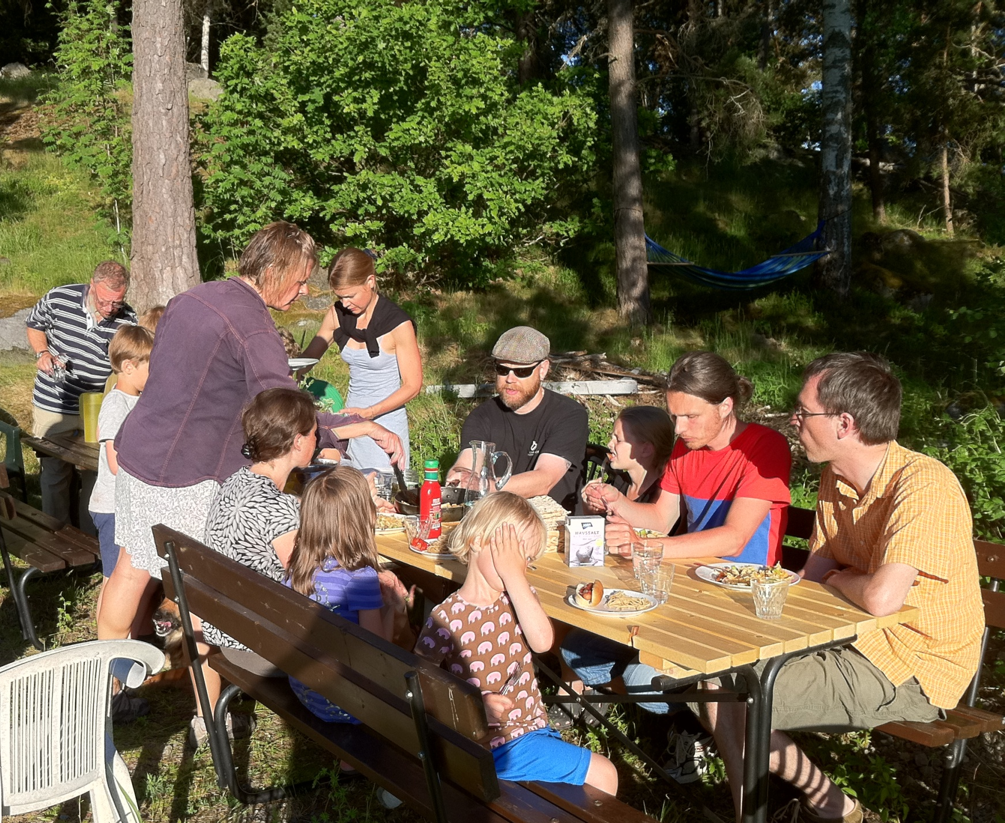
We have enjoyed making food for each other and dining together

Slide 40
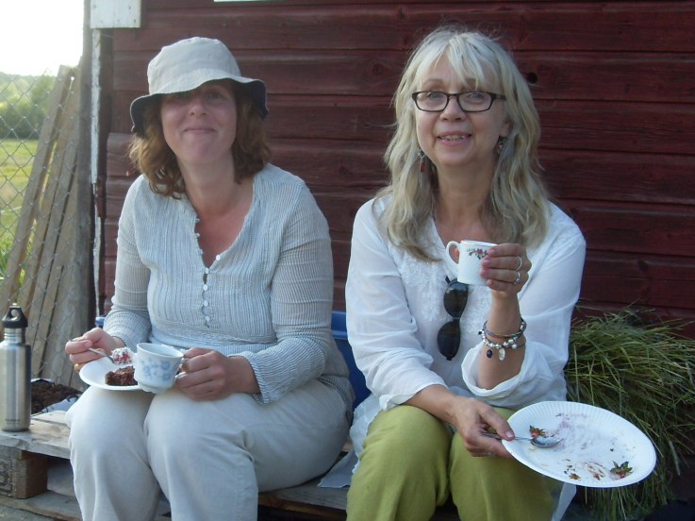
We have enjoyed some great moments with simple pleasures

Slide 41
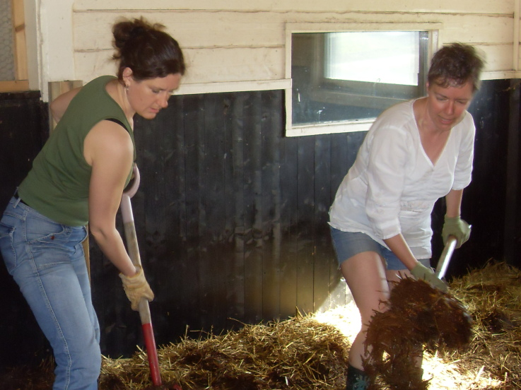
Experienced the mental and physical rewards of using your body

Slide 42
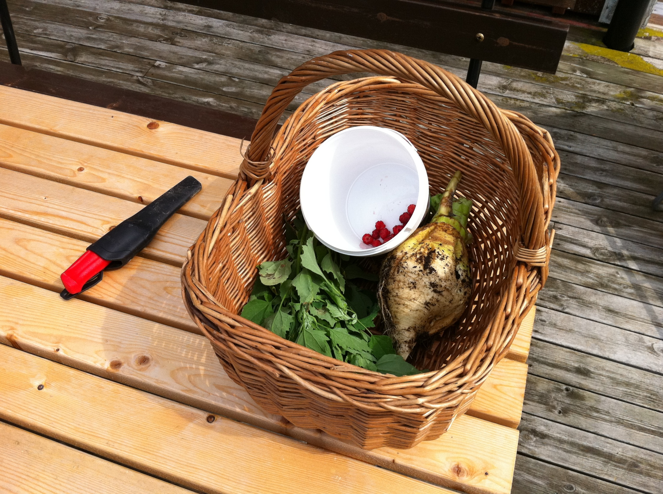
Just gone and got food from outside the door

Slide 43
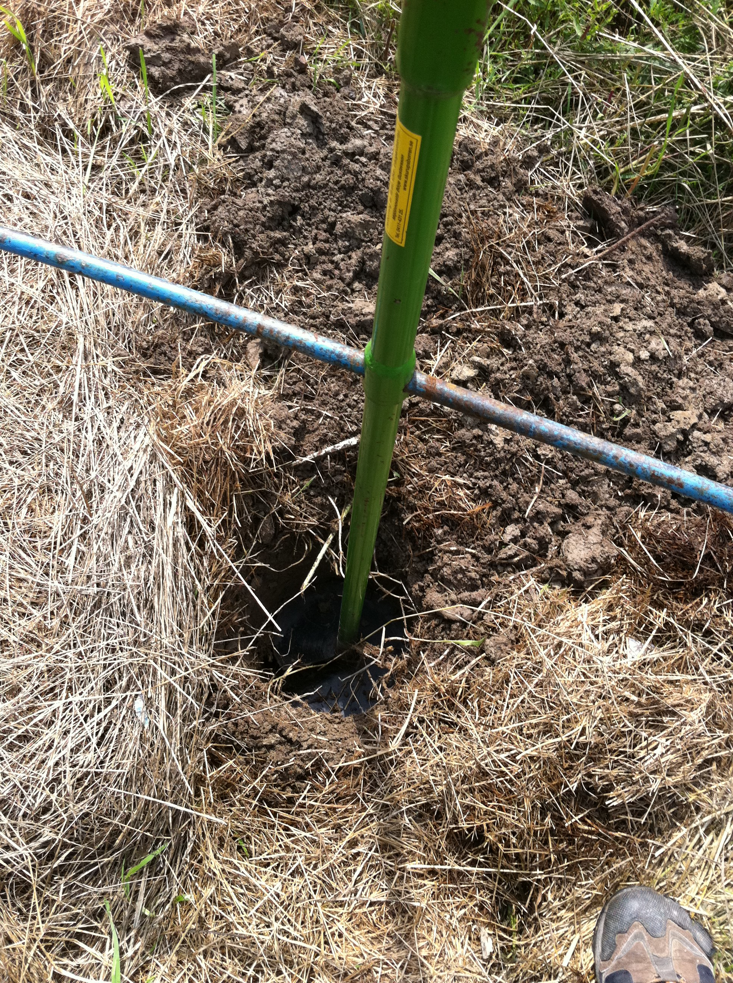
Worked out simple solutions like using an earth drill and….

Slide 44
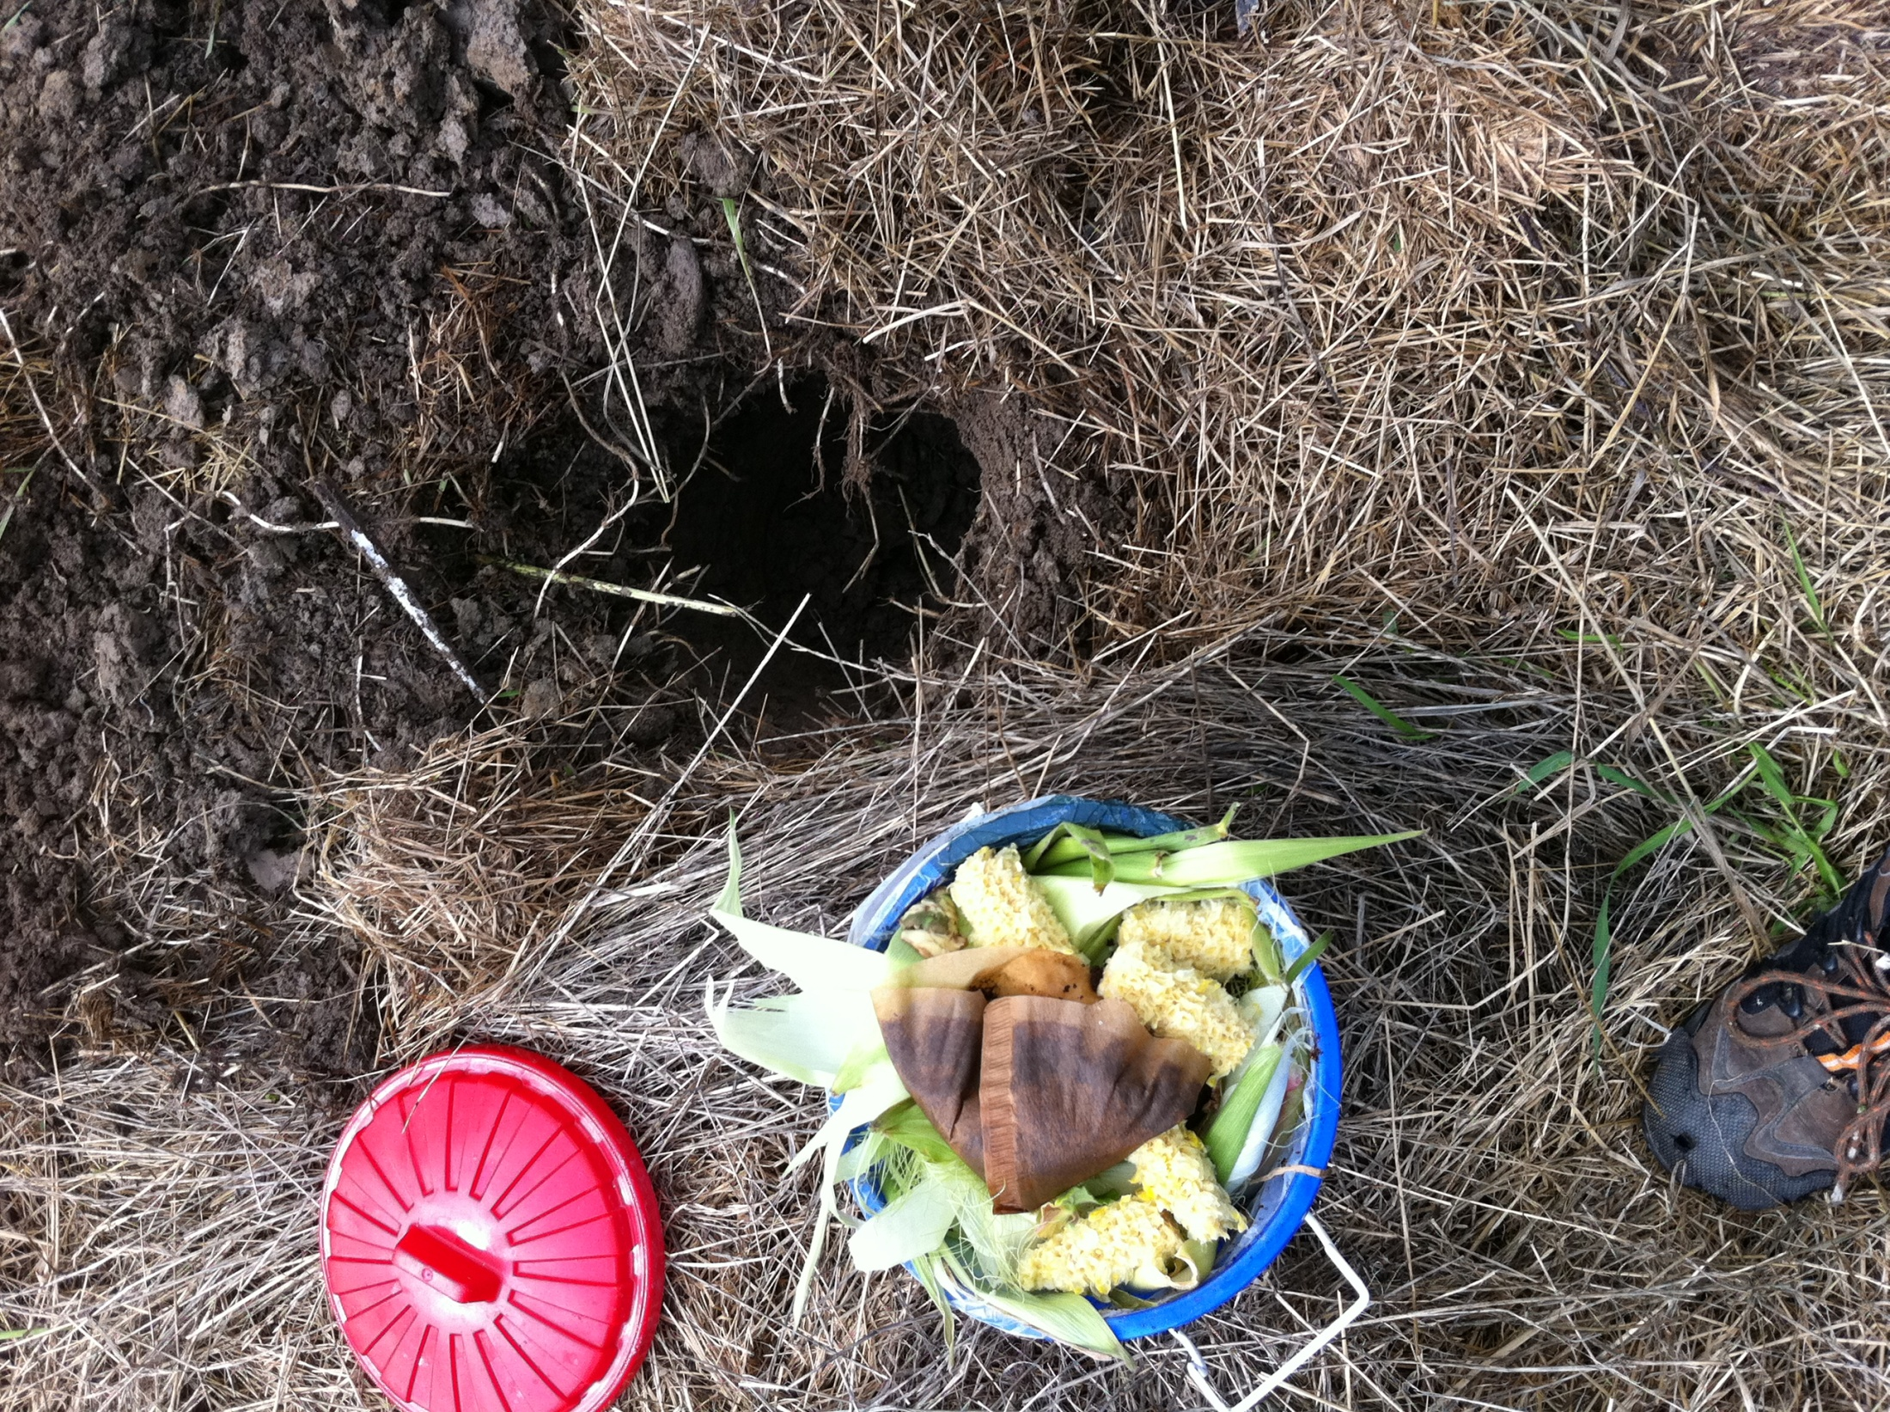
Putting your green compost directly in it.

Slide 45
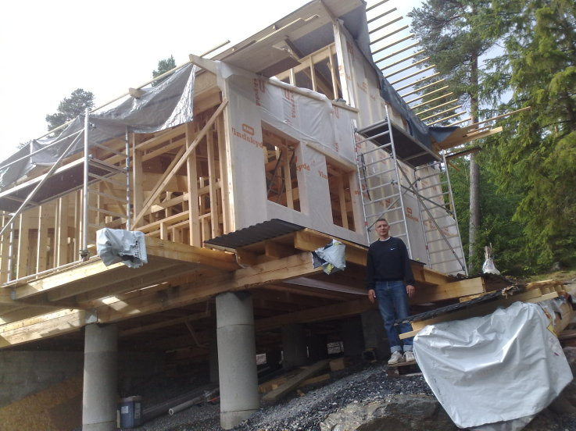
Planned, financed and started two new homes.

Slide 46
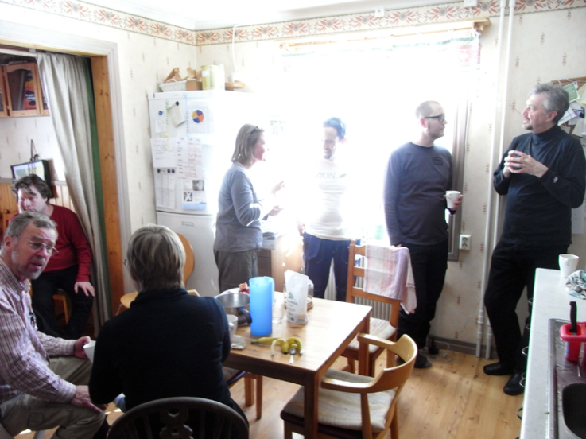
Found ourselves talking…. A lot.

Slide 47
Opportunities open up
Investing in Open World Villages in savings plans
Turning neighbourhoods into eco-units/open world villages
Using land you own to make the change

Slide 48
There’s plenty left to do…
Get planning permission for the other houses
Do the group dynamics, team building, ”cleaning backwards” stuff
Work out how to find that farmer and deliver food for 15 families
Continue to develop nutrient recycling and water handling
Get a firm grip on financial and project plans

Slide 50
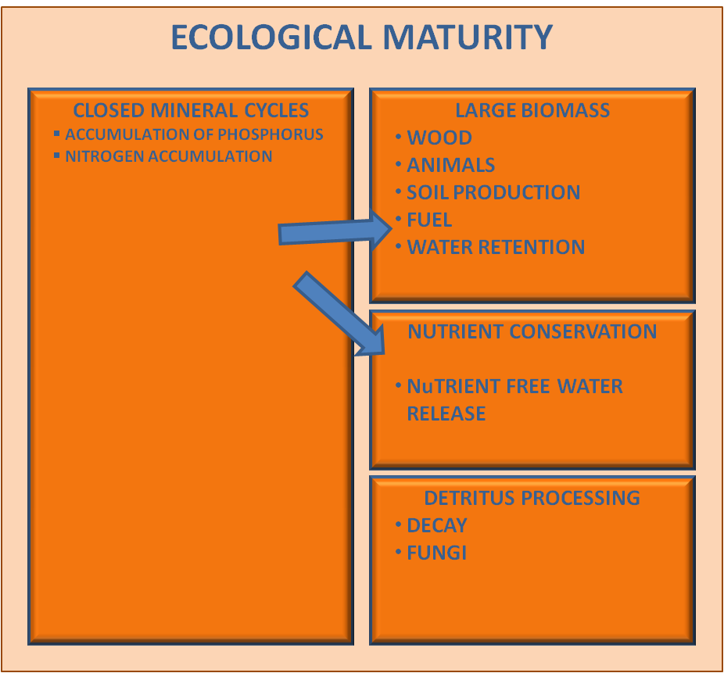

Slide 51
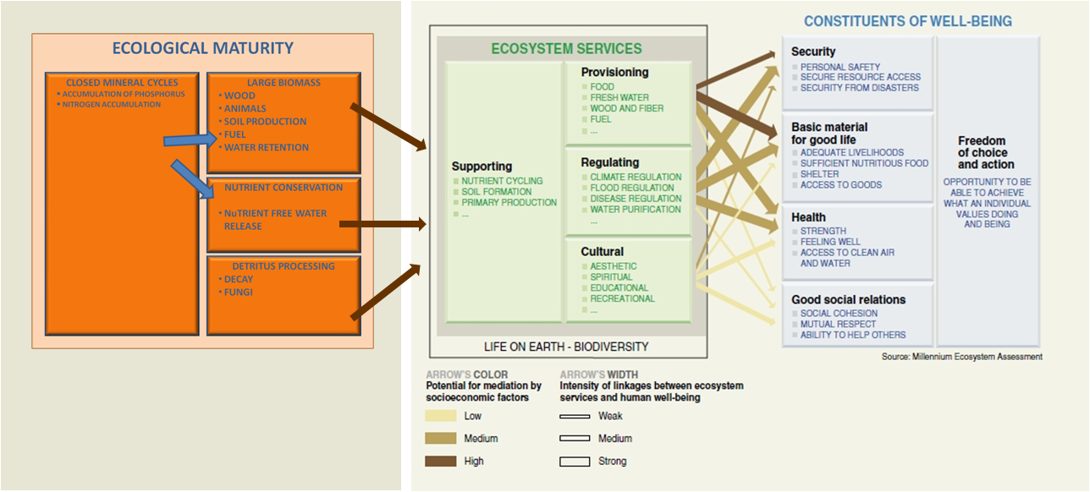

Slide 52
Share value
Time

Slide 53
atmosphere
biosphere
technosphere
geosphere
Notes:
53

Slide 54
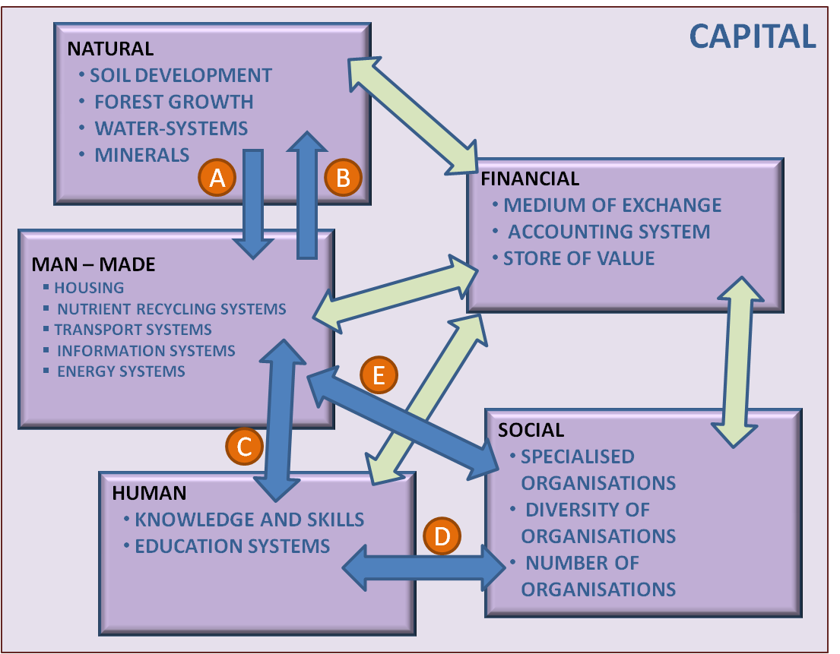

Slide 55
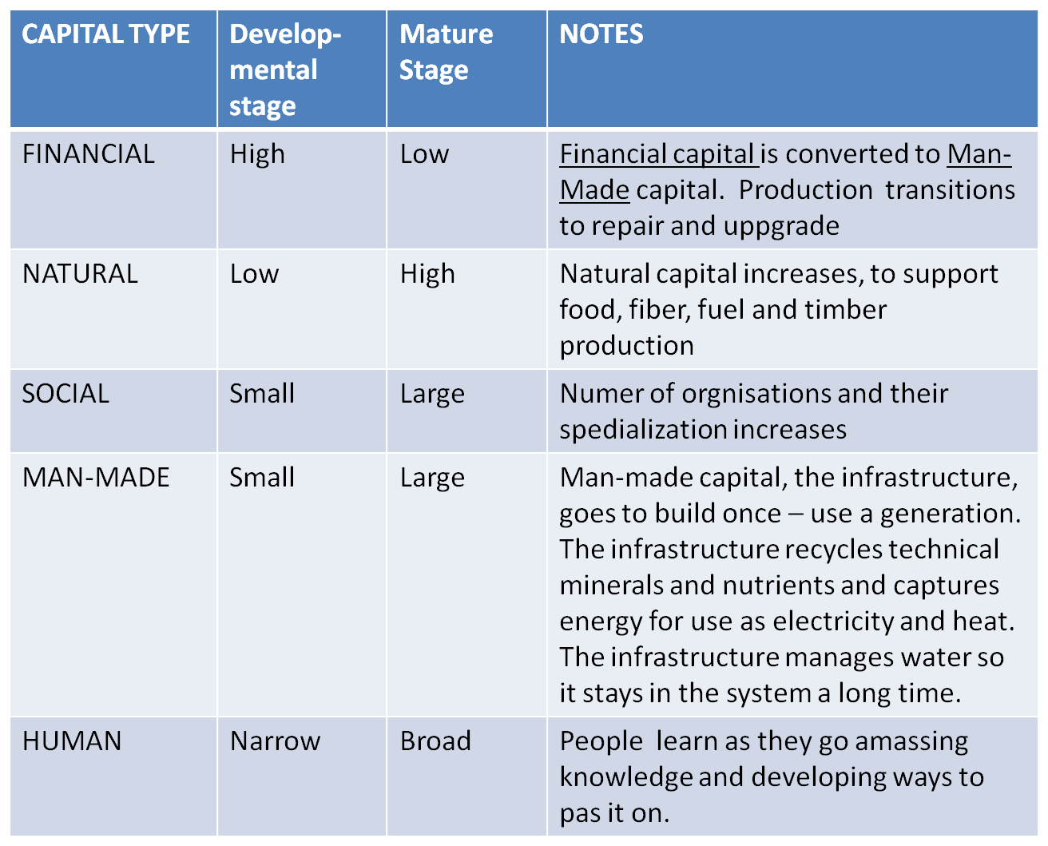

Slide 56
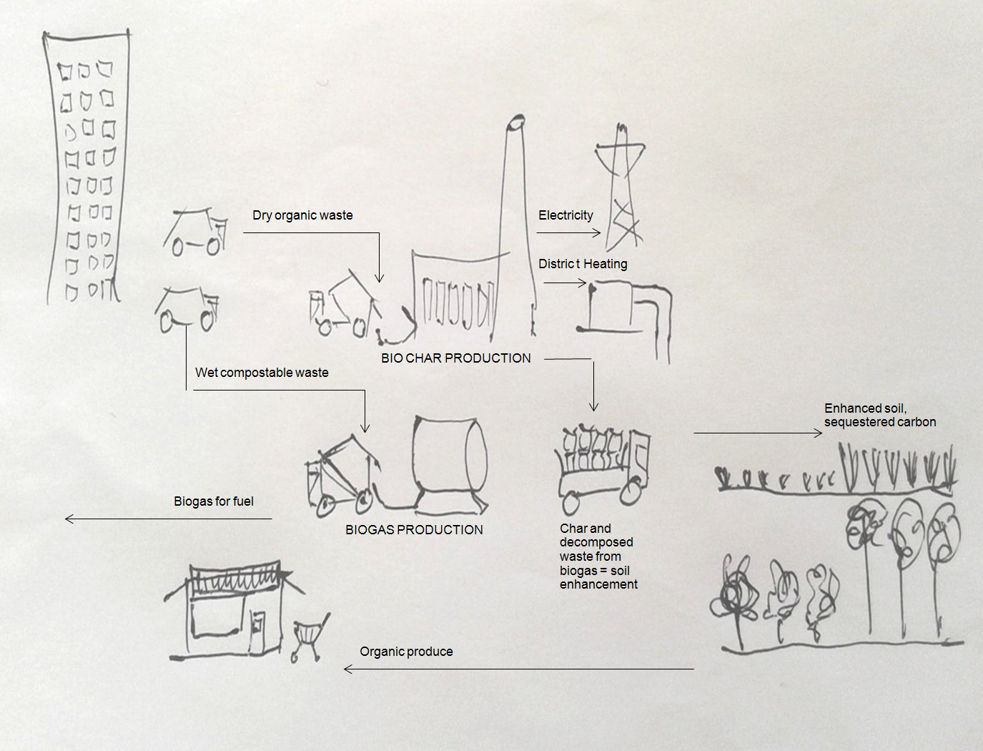
1
2
3
4
7
8
5
6
9

