Slide 1
THINKING BEHIND RECONOMY
WHERE CITIES FIT IN
EXAMPLES
BOOK, REFERENCES AND IDEAS TO FOLLOW UP ON
Stephenhinton.org

Slide 2
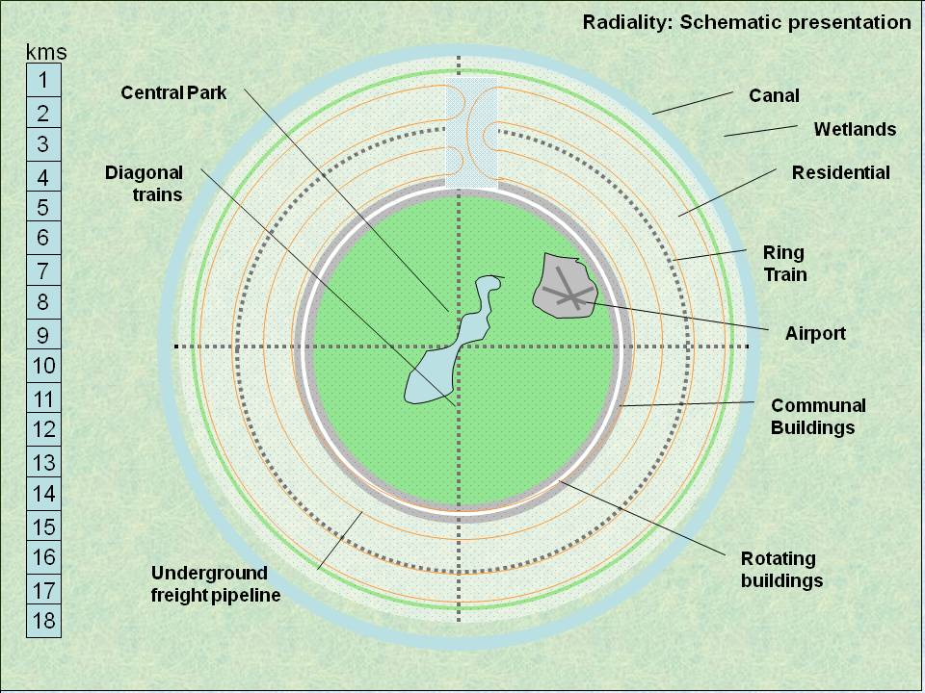
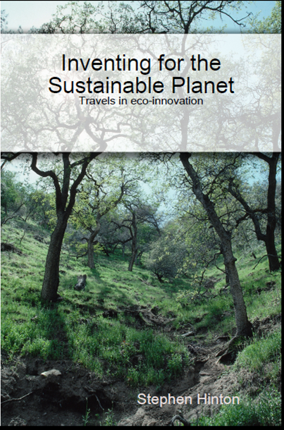

Slide 3
DESIGN CHALLENGE
Create a device to keep people out of your living space but allows you to pass freely. Solution shall be effective (works in most cases except for e.g. excessive force), and as sustainable as current technology allows

Slide 4
paradigm
Definition
Intellectual perception or view, accepted by an individual or a society as a clear example, model, or pattern of how things work in the world. This term was used first by the US science fiction historian Thomas Kuhn (192296) in his 1962 book 'The Structure Of Scientific Revolution' to refer to theoretical frameworks within which all scientific thinking and practices operate. See also paradigm shift.

Slide 5
Places to intervene in a system http://www.donellameadows.org/archives/leveragepointsplacestointerveneinasystem/
12. Constants, parameters, numbers (such as subsidies, taxes, standards).
11. The sizes of buffers and other stabilizing stocks, relative to their flows.
10. The structure of material stocks and flows (such as transport networks, population age structures).
9. The lengths of delays, relative to the rate of system change.
8. The strength of negative feedback loops, relative to the impacts they are trying to correct against.
7. The gain around driving positive feedback loops.
6. The structure of information flows (who does and does not have access to information).
5. The rules of the system (such as incentives, punishments, constraints).
4. The power to add, change, evolve, or self-organize system structure.
3. The goals of the system.
2. The mindset or paradigm out of which the system — its goals, structure, rules, delays, parameters — arises.
1. The power to transcend paradigms.

Slide 6
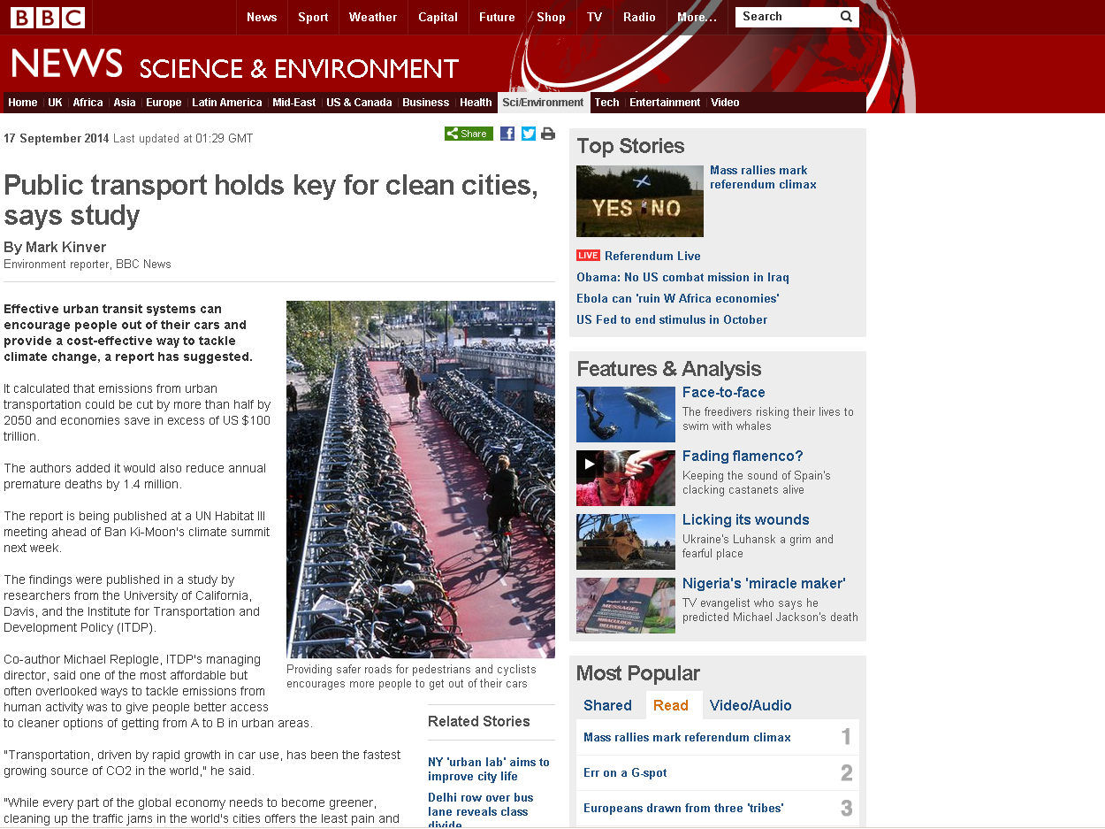
LEVEL 10 INTERVENTION: STRUCTURAL LEVEL

Slide 7
POLICY PERFORMANCE
Basic needs of citizens
NOT MET
MET
Sustainable
Poverty:
People lack basics but capital intact
Sustainable
Future
Maintaing/increasing
Capital Stewardship
Failed society
Capital depleted, people not served
Capital
depletion:
People served at expense of coming generations
Depleting
LEVEL 3 INTERVENTION: GOALS

Slide 8

Economy is not about money.
Economy is about living on what you have.

Slide 9
BRAVE NEW WORLD REVISITED ALDOUS HUXLEY
Organization is indispensable; for liberty arises and has meaning only within a self-regulating community of freely cooperating individuals. But, though indispensable, organization can also be fatal. Too much or­ganization transforms men and women into automata, suffocates the creative spirit and abolishes the very possibility of freedom. As usual, the only safe course is in the middle, between the extremes of laissez-faire at one end of the scale and of total control at the other.
During the past century the successive advances in technology have been accompanied by corresponding advances in organization. Complicated machinery has had to be matched by complicated social arrangements, designed to work as smoothly and efficiently as the new instruments of production. In order to fit into these organizations, individuals have had to de-individualize themselves, have had to deny their native diver­sity and conform to a standard pattern, have had to do their best to become automata.
The dehumanizing effects of over-organization are reinforced by the dehumanizing effects of overpopulation. Industry, as it expands, draws an ever greater proportion of humanity's increasing numbers into large cities. But life in large cities is not conducive to mental health (the highest incidence of schizophrenia, we are told, occurs among the swarming inhabitants of industrial slums); nor does it foster the kind of responsible freedom within small self-governing groups, which is the first condition of a genuine democ­racy. City life is anonymous and, as it were, abstract. People are related to one another, not as total person­alities, but as the embodiments of economic functions or, when they are not at work, as irresponsible seekers of entertainment. Subjected to this kind of life, indi­viduals tend to feel lonely and insignificant. Their ex­istence ceases to have any point or meaning.
Biologically speaking, man is a moderately gregar­ious, not a completely social animal a creature more like a wolf, let us say, or an elephant, than like a bee or an ant. In their original form human societies bore no resemblance to the hive or the ant heap; they were merely packs. Civilization is, among other things, the process by which primitive packs are transformed into an analogue, crude and mechanical, of the social in­sects' organic communities. At the present time the pressures of overpopulation and technological change are accelerating this process. The termitary has come to seem a realizable and even, in some eyes, a desirable ideal. Needless to say, the ideal will never in fact be realized. A great gulf separates the social insect from the not too gregarious, big-brained mammal; and even though the mammal should do his best to imitate the insect, the gulf would remain. However hard they try, men cannot create a social organism, they can only create an organization. In the process of trying to create an organism they will merely create a totali­tarian despotism.
http://www.huxley.net/bnw-revisited/

Slide 10
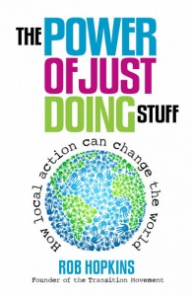
Jonathan Dimbleby, writer and broadcaster.
“Rob’s book is a manual of practical wisdom; it is hopeful and realistic, it shows what can be achieved, it encourages us to think beyond the self, beyond the rules. There is a wealth of thriving examples in this book that show how quickly positive change can happen, how social enterprise does actually make a very sound investment, how sharing skills and time enriches a community. I believe that in the future Rob Hopkins will be seen as influential as EF Schumacher, the original Permaconomist. The Power of Just Doing Stuff will sit alongside my copy of Small is Beautiful and in time, will be just as well-thumbed”.

Slide 11


What’s the REconomy Project?
We are here to help build the capacity of Transition Initiatives, and other similar community groups, to transform their local economies.
Transition Network
REconomy Project is part of the Transition Network, supporting community led change towards a low carbon, socially just and happier future.
LERAKET
Arose from JAK BANK decision to support local economic development provides tools to build local economy
http://www.reconomy.org/

Slide 12
PRE-CONSCIOUS
AWARENESS
SENSE OF PLACE
SENSE OF COMMUNITY
ENGAGEMENT
ENTERPRISES
GROUPS
PROJECTS

Slide 13

PLACE, Vision
Transition Enterprises
Local Products
Local investment, Currency
Social Cohesion Projects
Buy local
Volunteer projects
PLACE, Local identity
Engaged People

Slide 14
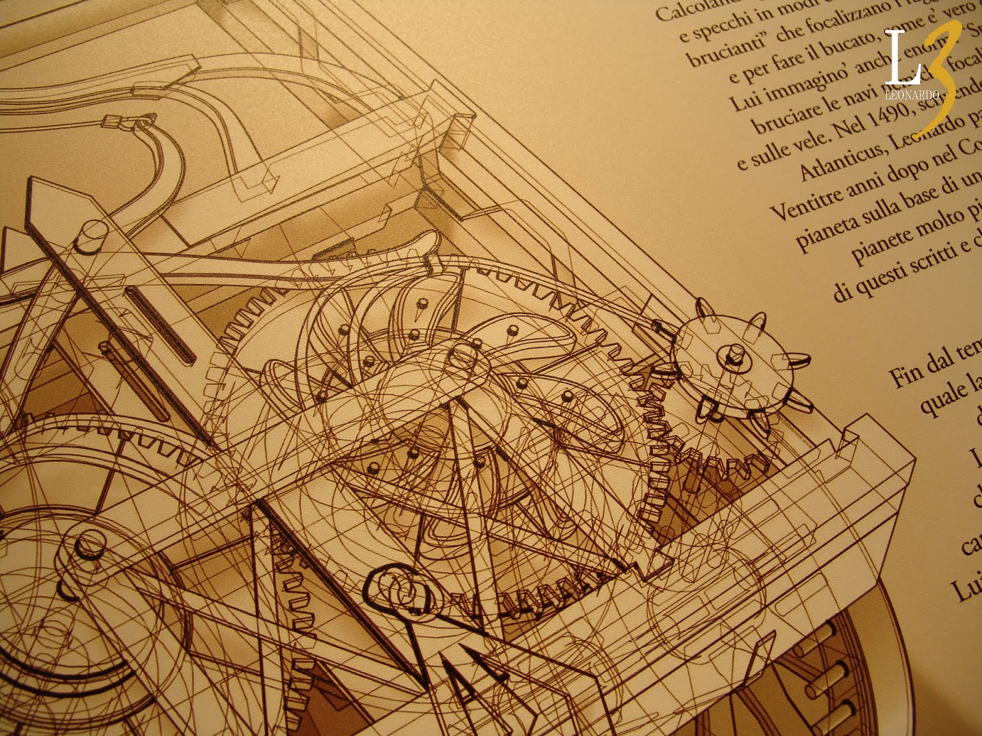
PASSION IS NOT A SALARYMAN

Slide 15
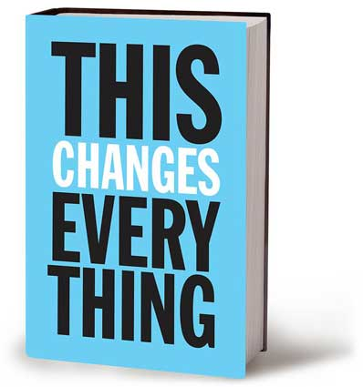
Another part of what makes climate change so very difficult
for us to grasp is that ours is a culture of the perpetual
present, one that deliberately severs itself from the past
that created us as well as the future we are shaping with
our actions. Climate change is about how what we did
generations in the past will inescapably affect not just the
present, but generations in the future. These time frames
are a language that has become foreign to most of us.
This is not about passing individual judgment, nor about
berating ourselves for our shallowness or rootlessness.
Rather, it is about recognizing that we are products of an
industrial project, one intimately, historically linked to fossil fuels.
And just as we have changed before, we can change again. After listening to the great farmer-poet Wendell Berry deliver a lecture on how we each have a duty to love our “homeplace” more than any other, I asked him if he had any advice for rootless people like me and my friends, who live in our computers and always seem to be shopping for home. “Stop somewhere,” he replied. “And begin the thousand-year-long process of knowing that place.”
That’s good advice on lots of levels. Because in order to win this fight of our lives, we all need a place to stand.
THIS CHANGES EVERYTHING BY NAOMI KLEIN

Slide 16
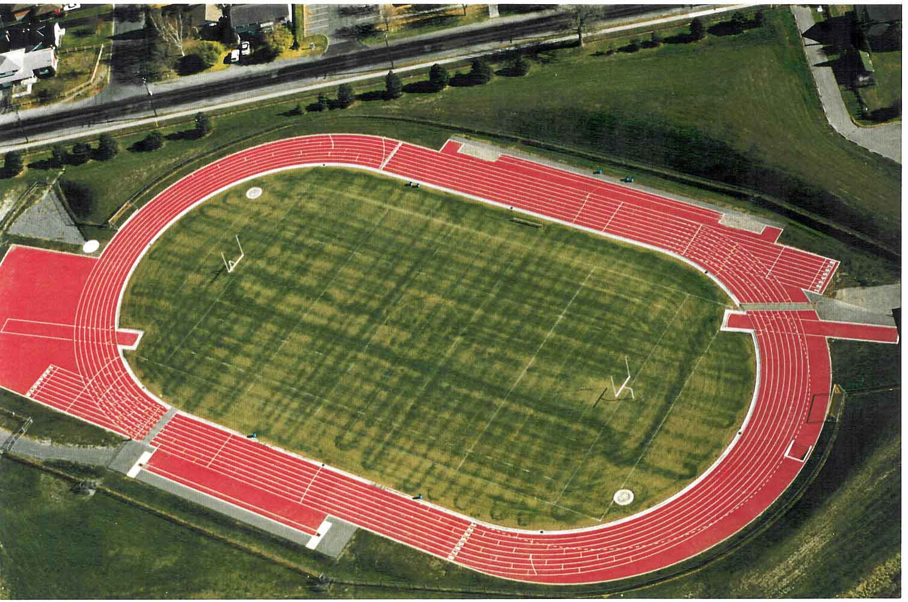
100m
SENSE OF PLACE: HOW BIG IS A HECTARE
HOW MANY DO WE HAVE EACH?
HOW MUCH DO WE NEED?

Slide 17
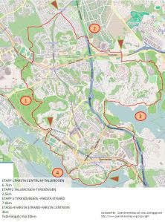
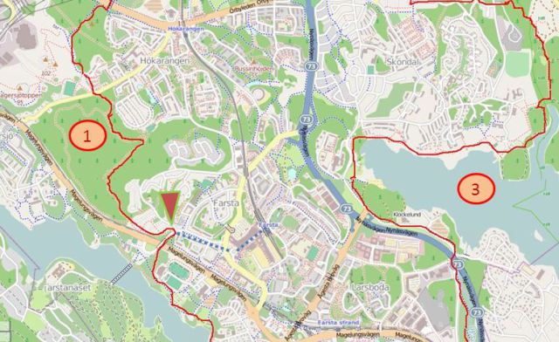
SENSE OF PLACE: ROUND WALKS IN FARSTA

Slide 18
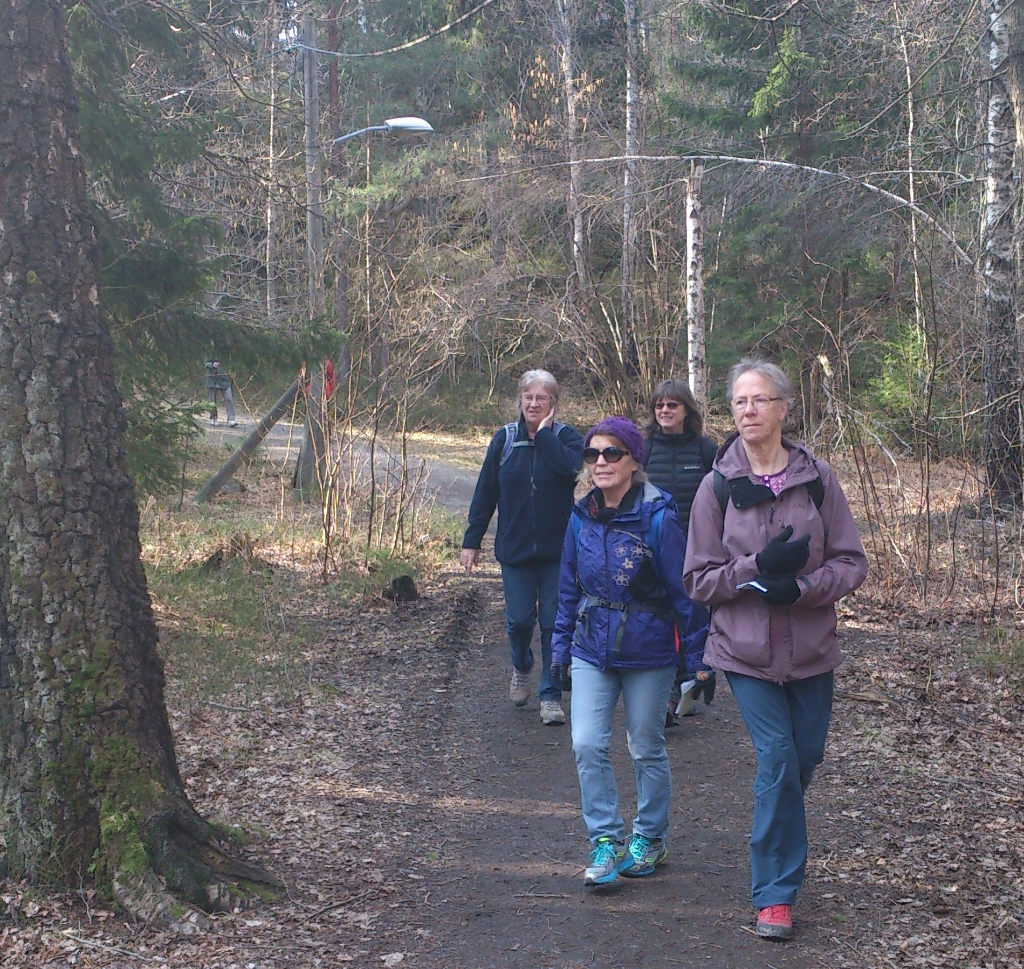
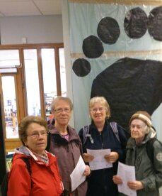

Slide 19
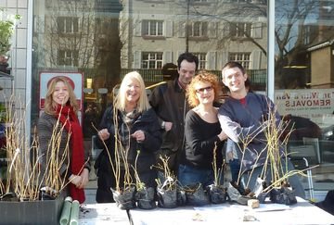
SENSE OF COMMUNITY: GIVING AWAY TREES
BELIZE, LONDON

Slide 20
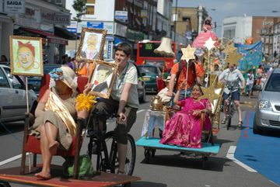
SENSE OF COMMUNITY: TRASHCATCHERS CARNIVAL

Slide 21
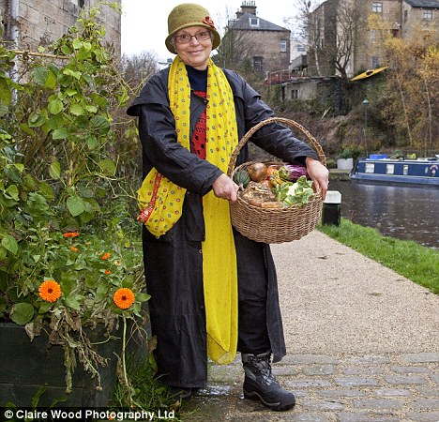
SENSE OF COMMUNITY: GROWING FREE FOOD EVERYWHERE – INCREDIBLE EDIBLE

Slide 22
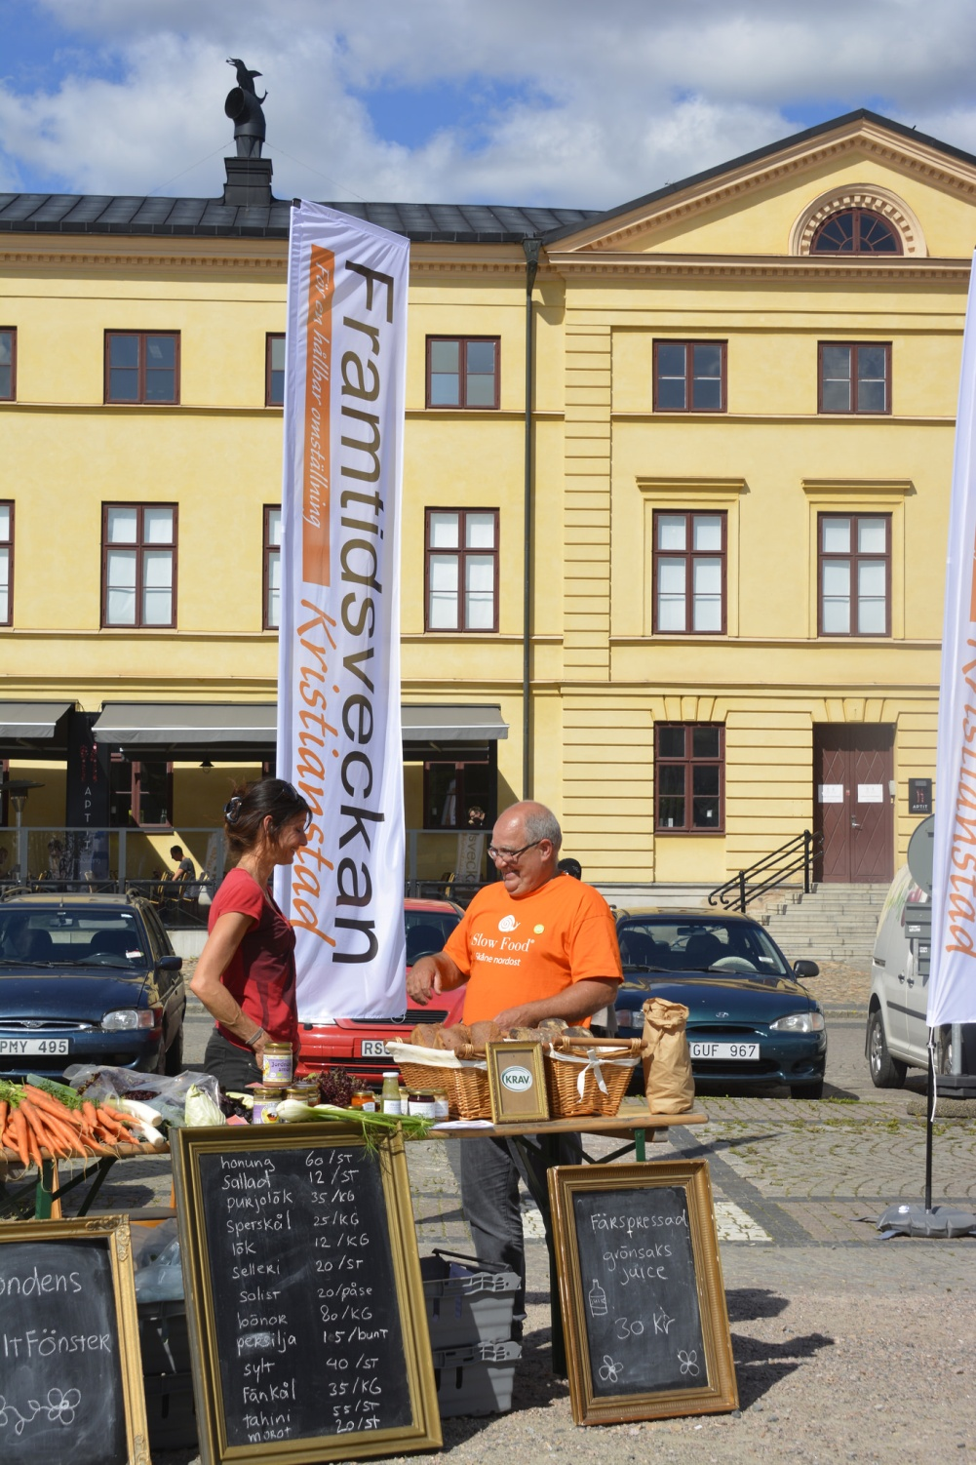
SENSE OF PLACE: FUTURE WEEKS
Photo: Kristianstads kommun

Slide 23

Lessons from Svartådalen
Coordination organization - Svartådalens Rural Development Economic Association,
physical hub and meeting point in the village hall
Project separate but coordinated - with paid project manager
Participation - inform, dialogue, working groups, external information
Interact. Voluntary, private and public sector
Networking - Local, Regional, National, International
Start with pilot studies and a strategy

Slide 24
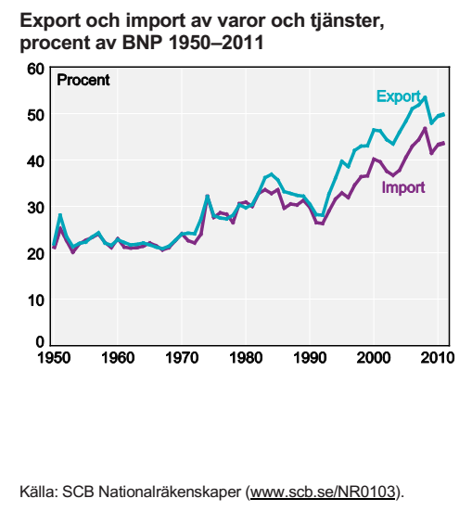
THE MORE WE EXPORT, THE MORE WE IMPORT

Slide 25
Characteristics of a Transition Enterprise
1. Resilience outcome
2. Appropriate resource use
3. Appropriate localisation.
4. More than profit
5. Part of the community

Slide 26
Characteristics of a Transition Enterprise
1. Resilience outcome – TEs contribute to the increased resilience of communities in the face of, for example, economic uncertainty, energy and resource shortages and climate change impacts. As part of their community, TEs are also resilient in themselves, seeking to be financially sustainable and as independent as possible of external funding.
2. Appropriate resource use - TEs make efficient and appropriate use of natural resources (including energy), respecting finite limits and minimising and integrating waste streams. The use of fossil fuels in particular is minimised.
3. Appropriate localisation – TEs operate at a scale appropriate to the environment, economy and business sector with regard to sourcing, distribution and interaction with the wider economy.
4. More than profit – TEs exist to provide affordable, sustainable products and services and decent livelihoods rather than to generate profits for others. TEs can be profitable, but the use of their excess profits prioritises the community benefit rather than benefit to investors.
5. Part of the community - TEs work towards building a common wealth, owned and controlled as much as is practical by their workers, customers, users, tenants and communities. They have structures or business models which are as open, autonomous, equitable, democratic, inclusive and accountable as possible. They complement and work in harmony with other TEs.

Slide 27
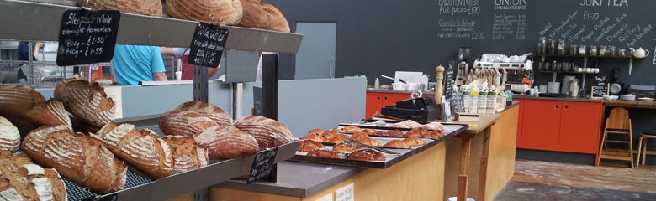
New ways to make a living and meet Transition’s aims

Slide 28
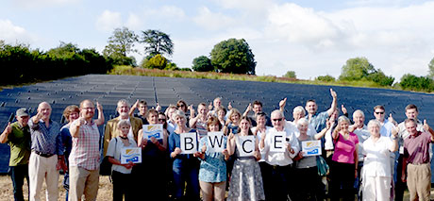
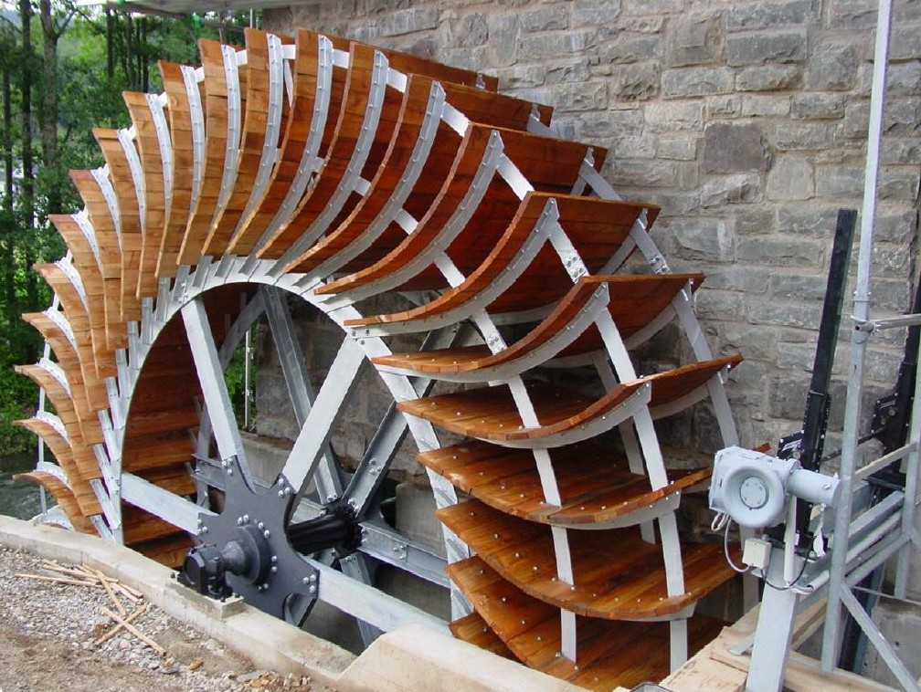
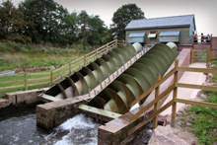
BWCE is a Community Benefit Society with a mission to develop as a financially sustainable community-owned energy enterprise, delivering renewable energy, energy efficiency and energy supply services, via a strong community model that will maximise local investment, strengthen our local economy and build community resilience.

Slide 29
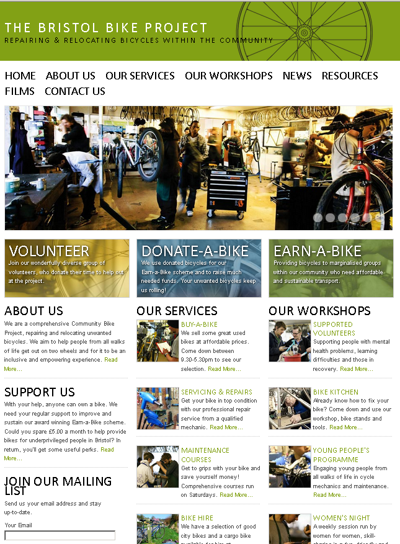

Slide 30
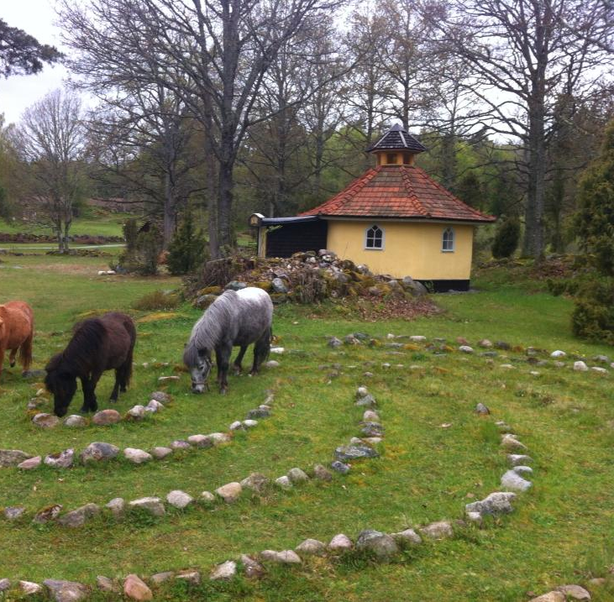
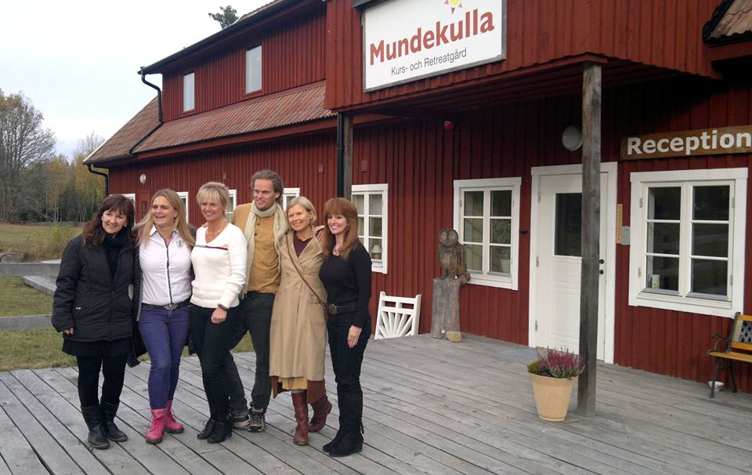
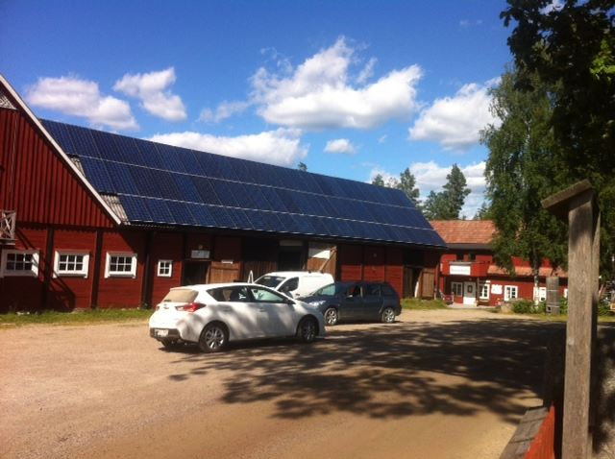
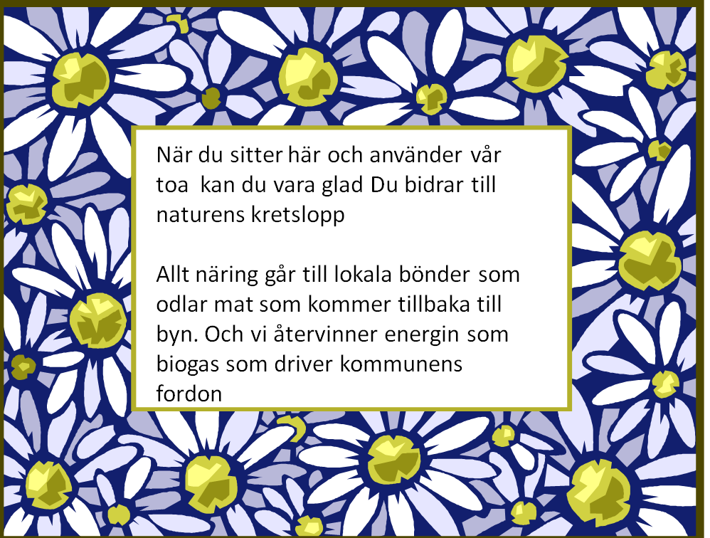

Slide 31
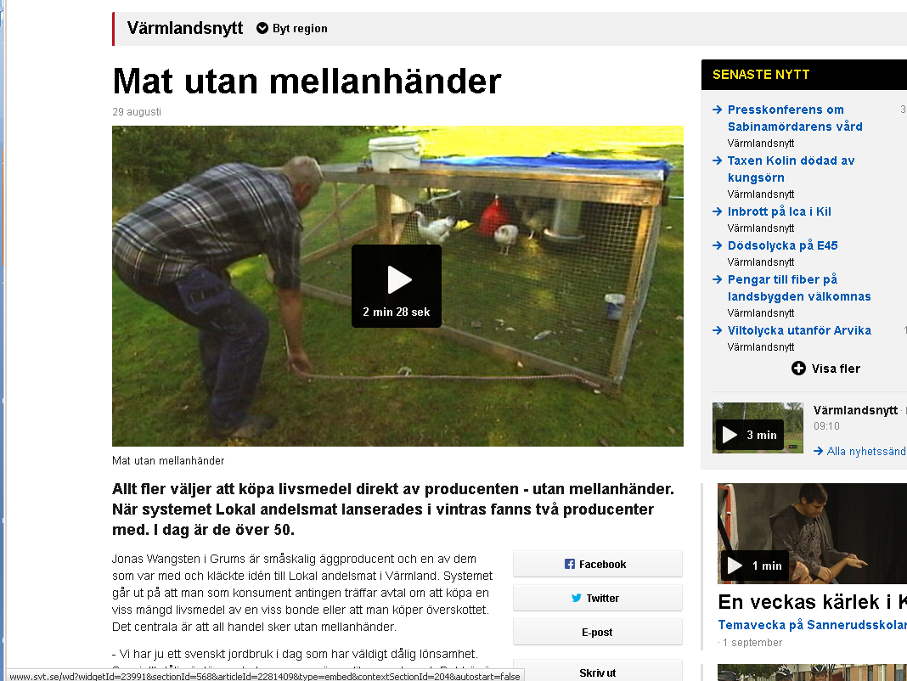
http://www.svt.se/nyheter/regionalt/varmlandsnytt/mat-utan-mellanhander

Slide 32
A few questions and statements
QUESTIONS
How can you design urban areas to:
  Reduce fossil fuel transport demand
  Promote doing business with people you know
  Recycle biomass through ecosystems and retain minerals in technosphere
STATEMENTS
Society is failing at a rules and paradigm level
Redesign at stocks and flow level will not bring about sustainability
You can’t redesign urbans areas to make any lasting change unless you work higher levels in the system. But you can make pivotal changes at the right point in a system

Slide 33
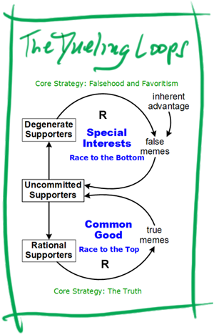
http://www.thwink.org/sustain/glossary/DuelingLoops.htm

